Slide 1
HOTEL BOOKING ANALYSIS
SINDHU K

Slide 2
CONTENTS
DATASET
DATA CLEANING
DATA VISUALIZATION
UNIVARIATE ANALYSIS
HOTEL ANALYSIS
CANCELLATION ANALYSIS
ROOM TYPE ANALYSIS
RESERVATION STATUS ANALYSIS
PARKING STATUS ANALYSIS
SPECIAL REQUEST ANALYSIS
OTHER ANALYSIS
CORRELATION MATRIX
CONCLUSION

Slide 3
DATASET
Dataset contains 119390 rows and 32 columns
hotel---The datasets contains the booking information of two hotel. One of the hotels is a resort hotel and the other is a city hotel.
is_canceled---Value indicating if the booking was canceled (1) or not (0)..
arrival_date_year---Year of arrival date
arrival_date_month---Month of arrival date with 12 categories: “January” to “December”
arrival_date_week_number---Week number of the arrival date
arrival_date_day_of_month---Day of the month of the arrival date
stays_in_weekend_nights---Number of weekend nights (Saturday or Sunday) the guest stayed or booked to stay at the hotel.
stays_in_week_nights---Number of week nights (Monday to Friday) the guest stayed or booked to stay at the hotel BO and BL/Calculated by counting the number of week
adults---Number of adults
children---Number of children
babies---Number of babies
meal---BB – Bed & Breakfast

Slide 4
country---Country of origin.
market_segment---Market segment designation. In categories, the term “TA” means “Travel Agents” and “TO” means “Tour Operators”
distribution_channel---Booking distribution channel. The term “TA” means “Travel Agents” and “TO” means “Tour Operators”
is_repeated_guest---Value indicating if the booking name was from a repeated guest (1) or not (0)
previous_cancellations---Number of previous bookings that were cancelled by the customer prior to the current booking
previous_bookings_not_canceled---Number of previous bookings not cancelled by the customer prior to the current booking
reserved_room_type---Code of room type reserved. Code is presented instead of designation for anonymity reasons
assigned_room_type---Code for the type of room assigned to the booking. Sometimes the assigned room type differs from the reserved room type due

Slide 5
booking_changes---Number of changes/amendments made to the booking from the moment the booking was entered on the PMS
deposit_type---No Deposit – no deposit was made; Non Refund – a deposit was made in the value of the total stay cost; Refundable – a
agent---ID of the travel agency that made the booking
company---ID of the company/entity that made the booking or responsible for paying the booking. ID is presented instead of designation for
days_in_waiting_list---Number of days the booking was in the waiting list before it was confirmed to the customer
customer_type---Group – when the booking is associated to a group; Transient – when the booking is not part of a group or contract, and is not associated to other

Slide 6
adr---Average Daily Rate (Calculated by dividing the sum of all lodging transactions by the total number of staying nights)
required_car_parking_spaces---Number of car parking spaces required by the customer
total_of_special_requests---Number of special requests made by the customer (e.g. twin bed or high floor)
reservation_status---Check-Out – customer has checked in but already departed; No-Show – customer did not check-in and did inform
reservation_status_date---Date at which the last status was set. This variable can be used in conjunction with the ReservationStatus.

Slide 7
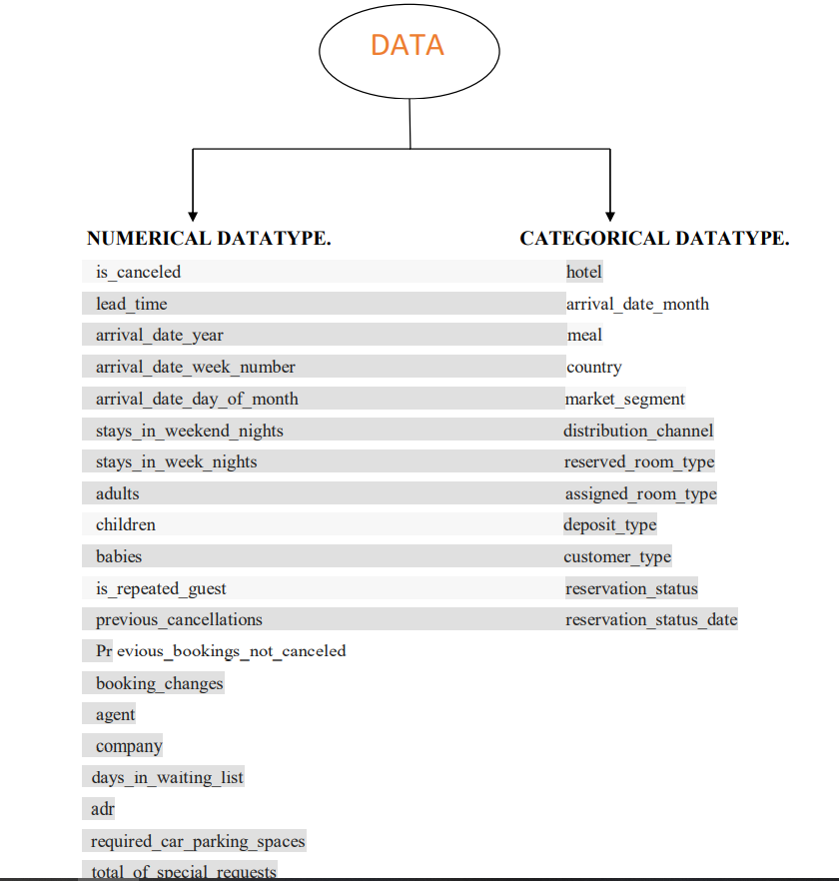

Slide 8
LIBRARIES
Important libraries of python used to perform exploratory data analysis are:
Numpy
Pandas
Matplotlib
Seaborn

Slide 9
DATA CLEANING
It is observed that agent and company column has null values so replacing null values in country and agent clumn with 0.
Replacing missing values in children column with mean of that column. This column has zero as value so it is inappropriate to replace missing value with 0.
Column country is objective type so to deal with missing value replacing missing values in country column with the mode of country column.
Datatype of children,agent and company if float64, converting that to int64.
reservation_status_date column datatype is changed to data_type.
There is 31994 rows of duplicate values, removing of such rows.
some rows have zero values in adults, children and babies columns. There is 166 rows of such type dropping that rows.

Slide 10
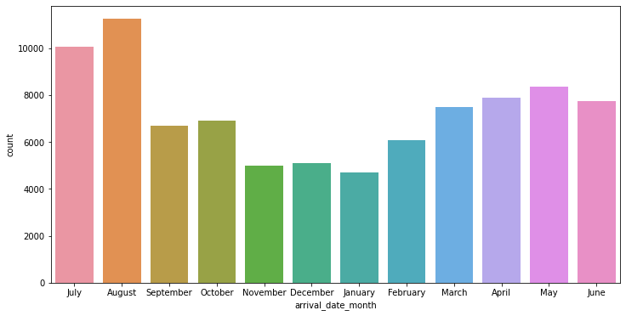
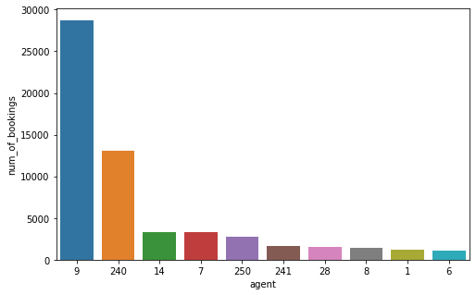
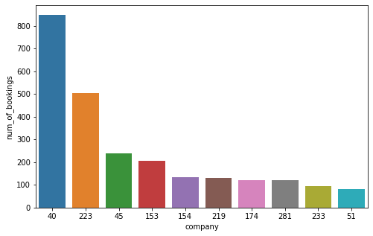
UNIVARIATE ANALYSIS:
The arrival of guests is more in August and July month.
The most no. of bookings is made by agent 9 and company with id 40.

Slide 11
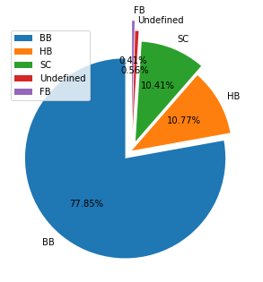
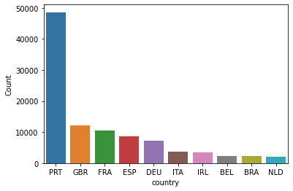
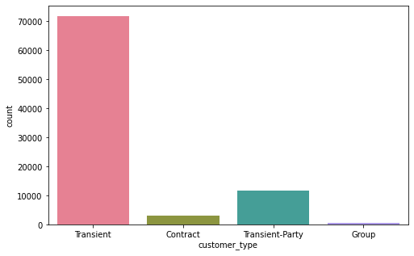
About 78% of guests have ordered BB(bread and breakfast).
Most of the customers are from Portugal(PRT), Great Britain. Majority of the guests are from European countries.
Transient type of customers has made more bookings where they have not included in contract.

Slide 12
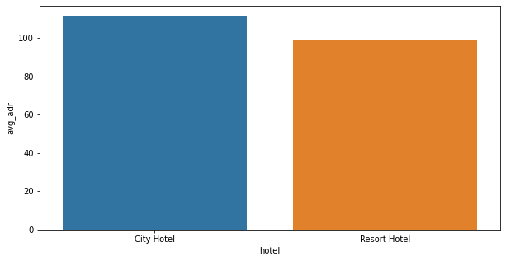
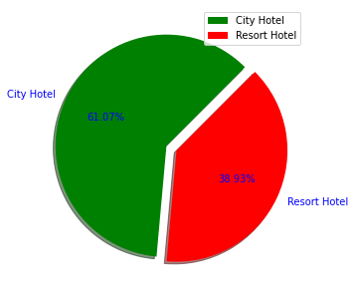
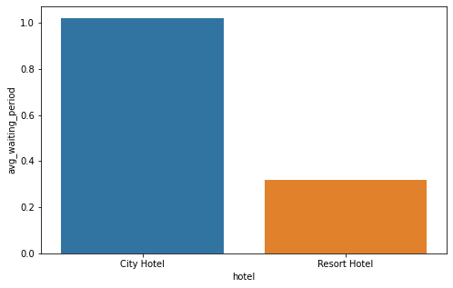
HOTEL ANALYSIS
From the above pie chart it is observed that bookings in city hotel is about 60% and 40% in resort hotel out of total bookings. City hotel has more bookings.
Both hotels have approximately equal adr. But city hotel has more adr compared to resort. Therefore city hotel generates more revenue.
City hotel has more chances of putting it's customer in waiting list.

Slide 13
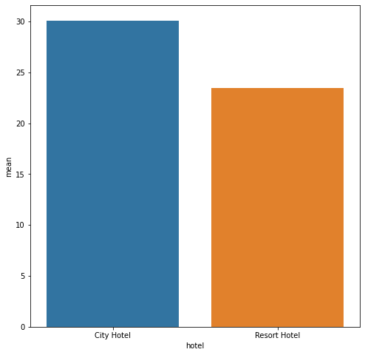
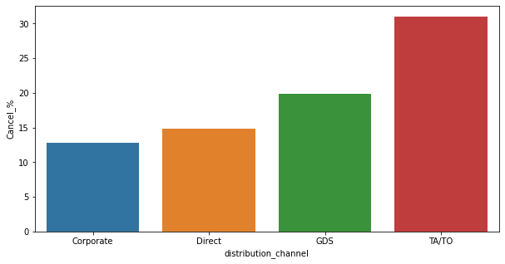
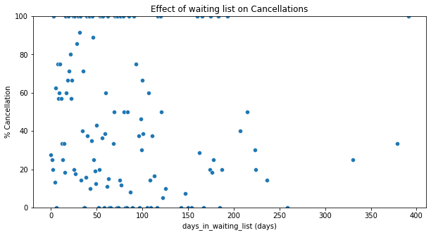
CANCELLATION ANALYSIS
Both hotels have approximately same cancellations. But city hotel has received more cancellation request.
Ta/to has more chances of doing cancellations.
Scatter plot is drawn between days_in_waiting_list and percentage of calculation. From the a graph it is clear that waiting period does not effect on cancellations

Slide 14
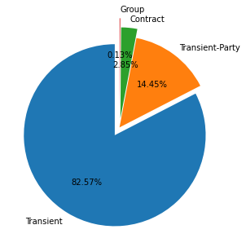
Out of all the cancellations transient type of customers have made more cancellations
i.e. 82.57% of customers who cancelled the bookings are transient type.

Slide 15
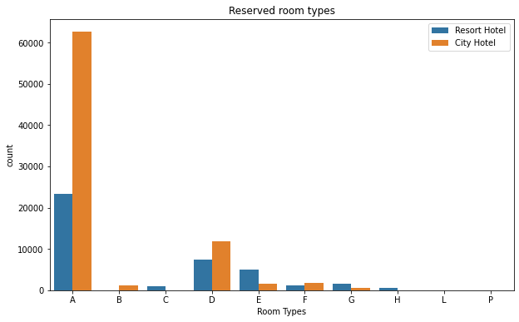
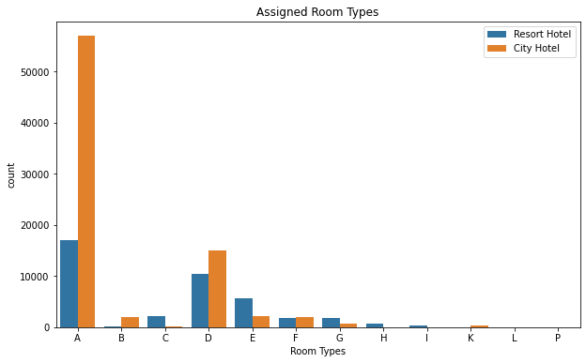
ROOM TYPE ANALYSIS
In both reserved and assigned room type it is observed that room type A is in demand. D and E room type also are in slight demand.

Slide 16
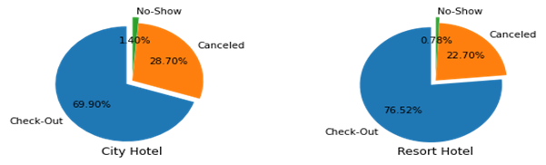
RESERVATION STATUS ANALYSIS
Pie chart is plotted for both city and resort hotel. In city hotel 70% of the customers who booked are checked out. In resort hotel 76% of the customers are checked out.

Slide 17
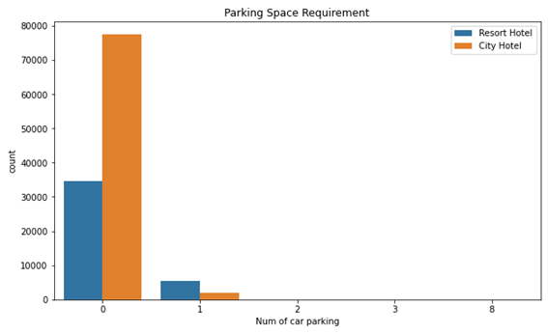
PARKING ANALYSIS
Most of the guests i.e. about 93% does not require parking space. Few guests have booked for one car parking. 2, 3 and 8 parking space requirement is very less.

Slide 18
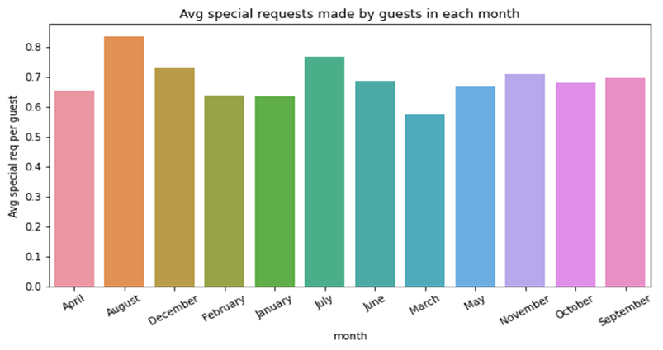
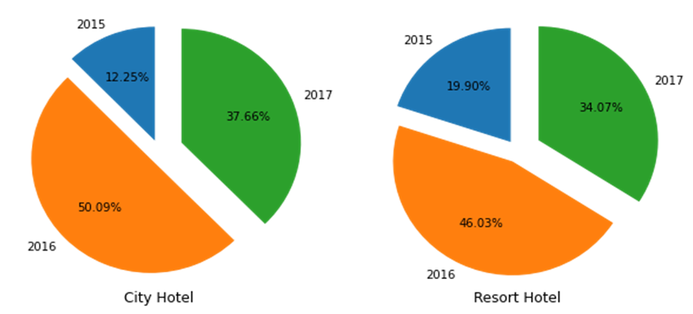
SPECIAL REQUEST ANALYSIS
Special requests are received more in August and July month.
The special requests made in 2016 is more compared to 2015 and 2017. But acompared to 2015 there is drastic increase in special requests in 2016 and 2017. So we can conclude that hotel will receive more special requets in coming years.

Slide 19
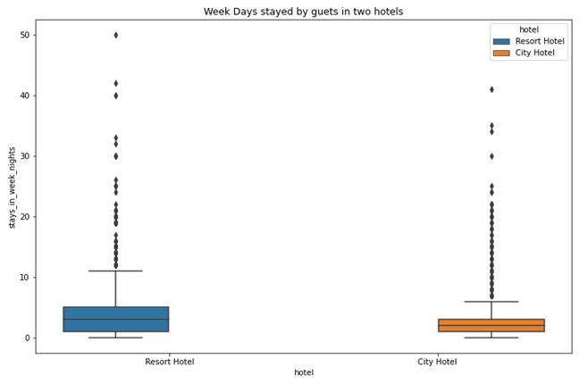
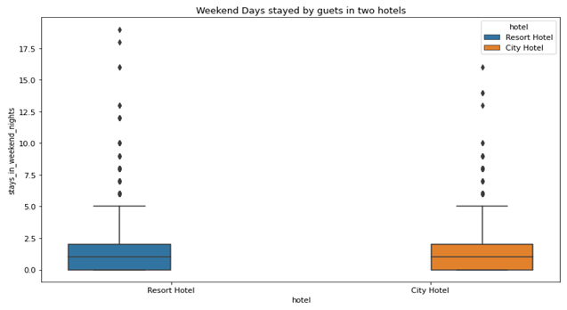
OTHER ANALYSIS
During week nights the average length of stay is less than 5 days in both the hotels. The maximum stay in resort hotel is approximately 50 days.

Slide 20
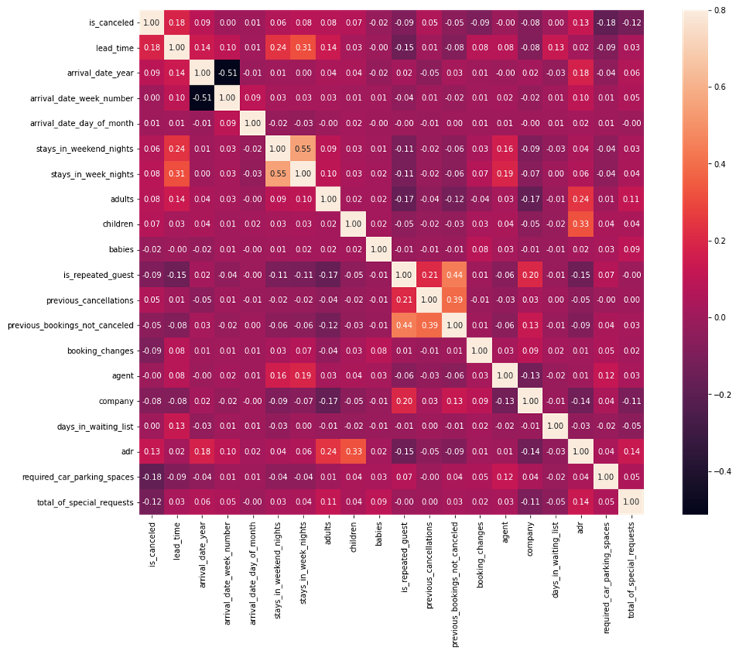
CORRELATION MATRIX
1.previous_bookings_not_cancelled is slightly correlated with is_repeated_guests. Repeated guests tends to visit the hotel more and because of the comfort they are less likely to cancel the bookings.
2. There is slight correlation between adr and chlidren. This shows that hotel generates more revenue with children booking.

Slide 21
CHALLENGES:
Some of the challenges faced while performing exploratory data analysis are:
Data contains a lot of null/NaN values.
There is lot of duplicate values.
Selecting appropriate type of visualization.

Slide 22
CONCLUSION:
The arrival of guests is more in August and july
The most bookings is made by company 40 and agent 9.
About 78% of guests has ordered BB(bread and breakfast).
Most of the customers are from Portugal(PRT). Bookings from other countries are very less.
Transient type of customers has made more bookings where they have not included in contract
Bookings in city hotel is about 60% and 40% in resort hotel out of total bookings. City hotel has more bookings.
That city hotel has more adr. Therefore city hotel generates more revenue compared to resort hotel.

Slide 23
City hotel has more chances of putting it's customer in waiting list. This is because due to city hotel receives more bookings.
Cancellations are made more in city hotel. Transient type of customers and TA/TO has more chances of doing cancellations.
Waiting period does not effect on cancellations.
Room type A is in demand. D and E room type also are in slight demand.
In city hotel 70% of the customers who booked are checked out. In resort hotel 76% of the customers are checked out.
It can be inferred that optimal lenght of stay in both the hotels is less than 5 days.

Slide 24
Most of the guests i.e. About 93% does not require parking space. Few guests have booked for one car parking. 2, 3 and 8 parking space requirement is very less.
Special requests are received more in August and July month and The special requests made in 2016 is more compared to 2015 and 2017. But acompared to 2015 there is drastic increase in special requests in 2016 and 2017. So we can conclude that hotel will receive more special requets in coming years.

